Slide 1

Profit Analysis
By
Kiran Mohanty

Slide 2
Introduction to the Dataset
The "Superstore Profit Analysis" dataset is a comprehensive and versatile collection of data that provides valuable insights into sales, Profit, customer behavior, and product performance. This dataset offers a rich resource for in-depth analysis.
Containing information from diverse regions and segments, the dataset enables exploration of trends, patterns, and correlations in sales and customer preferences. The dataset encompasses sales transactions, enabling researchers and analysts to understand buying patterns, identify high-demand products, and assess the effectiveness of different shipping modes.
Moreover, the dataset provides an opportunity to examine the impact of various factors such as discounts, geographical locations, and product categories on profitability. By analyzing this dataset, businesses and data enthusiasts can uncover actionable insights for optimizing pricing strategies, supply chain management, and customer engagement.
Whether used for educational purposes, business strategy formulation, or data analysis practice, the "Superstore Sales" dataset offers a comprehensive platform to delve into the dynamics of sales operations, customer interactions, and the factors that drive business success.

Slide 3
Key Columns Explanation
Row ID= This is a unique id that is assigned to each Row.
Order ID= This is an id that is assigned the unique number that gets assigned to an order placed by the customer.
Order Date= This is an date of order at which the date when each order was shipped or sent out for delivery.
Ship Date =The date that the order is shipped from the seller or warehouse to the customer.
Customer ID= This is a unique id that is assigned to each customer.
Customer Name= This is a name of customer which made by the order.
Segment= Describe a categorization of customers based on certain criteria, such as "Corporate," "Consumer," or "Home Office."
Country= This column specifies the country where each order was placed or shipped to.
City= This column contains the name of the city where the order was delivered.
State= This column likely stores the state or province information related to the delivery location.
Postal Code= This column typically contains the postal or ZIP code associated with the delivery address.
Region= This column may provide a broader geographical categorization, such as "West," "East," "North," or "South."
Product ID= This column stores a unique identifier for each product in the dataset, allowing you to link products to specific orders.
Category= This column categorizes products into broader groups, such as "Office Supplies," "Furniture," or "Technology."
Sub-Category= This column provides a more detailed categorization of products within each category. For example, under "Binders","Paper","Furnishings","Phones","Storage","Art","Accessories","Chairs","Appliances","Labels","Tables","Envelopes".
Product Name= This column contains the name or description of each individual product.
Sales= This column represents the total sales revenue generated by each order or product. It typically includes the price and quantity sold.
Quantity= This column indicates the number of units or items sold for each product in an order.
Discount= This column may contain information about any discounts applied to the products in an order.
Profit=This column typically shows the profit earned from each order or product, taking into account factors such as cost, price, and discounts.

Slide 4
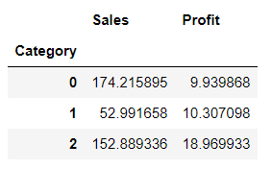
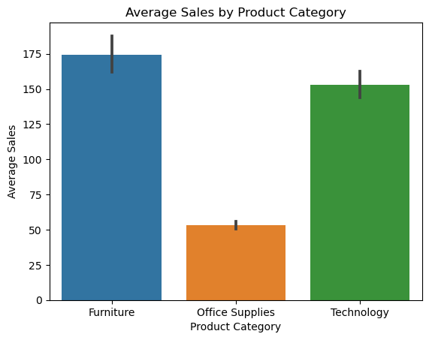
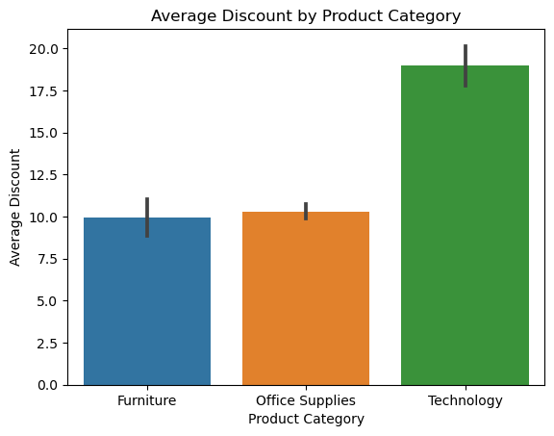
Analysis Opportunities
Furniture has the highest sales but the lowest profit to others.
Suggestions:-(High sales might be due to a wide variety of products. Consider focusing on higher-margin items.)
Technology comes second in sales and has the highest profit to others.
Suggestions:-(Maintain quality and customer satisfaction to sustain high-profit margins)
Office Supplies have both the lowest sales and the lowest profit.
Suggestions:-(Assess the demand for office supplies and potentially lookup for more product offerings.)

Slide 5
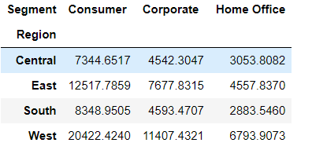
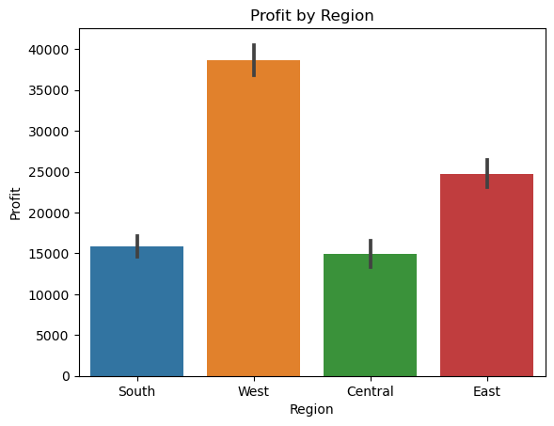
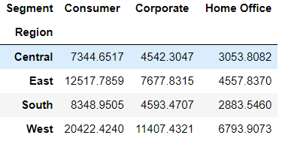
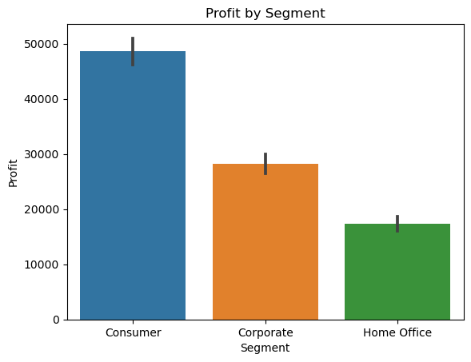
Consumer Segment:-This segment likely includes individual customers, representing people who make purchases for personal use. They may buy products for their homes, personal offices, or other individual needs.
Home Office Segment:-This segment is likely focused on customers who have a specific home office setup. These customers may purchase office supplies, equipment, or furniture for their home-based work or businesses.
Corporate Segment:-The corporate segment typically includes businesses and organizations. These customers may make bulk purchases of office supplies, furniture, and technology equipment for their employees or company use.
When considering the impact of region, it's notable that the West Region leads with the highest profit, followed closely by the East Region as the second-highest.
The other two regions have fairly similar profit levels. Additionally, within each region,
the Consumer segment consistently generates the highest profit, while the Corporate segment comes in second. On the other, the Home Office segment consistently records the lowest profit across all regions.

Slide 6
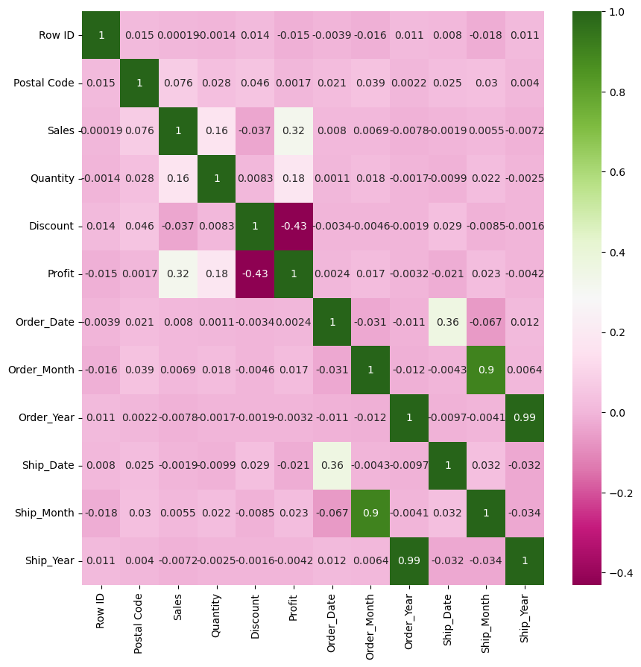
Correlation
Sales and Profit:-
There is a positive correlation 32% between Sales and Profit. This indicates that as Sales increase, Profit tends to increase as well.
Discount and Profit:-
There is a negative correlation -43% between Discount and Profit. This suggests that higher discounts are associated with lower profits.
Discount and Sales:-
There is a negative correlation -37% between Discount and Sales. This suggests that higher discounts may be associated with slightly lower sales.
There is an 90% multicollinearity with Order Month and Ship Month
There is an 99% multicollinearity with Order year and Ship year

Slide 7
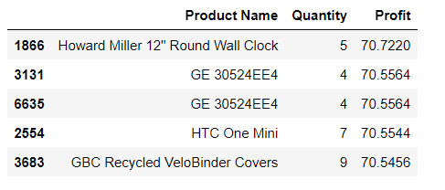
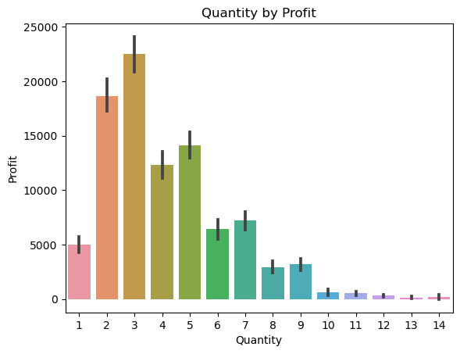
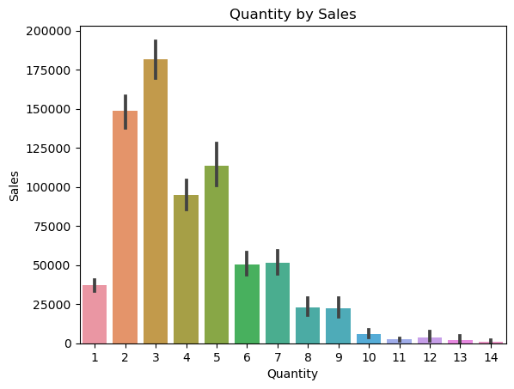
Top Selling Products in terms of Profit and Quantity
The majority of customers opt to purchase 3 quantities of an items, resulting in higher sales and profit. In contrast, when 14 quantities of an items are selected, both sales and profit tend to be lower.

Slide 8
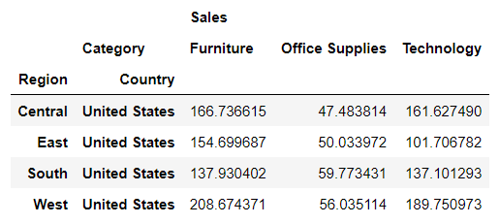
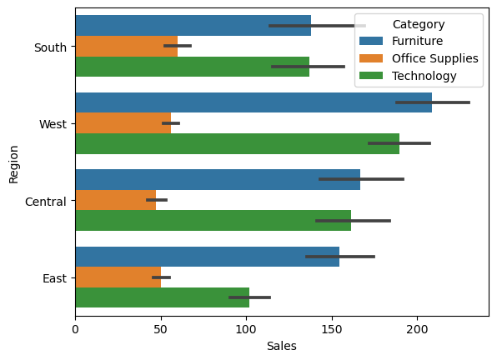
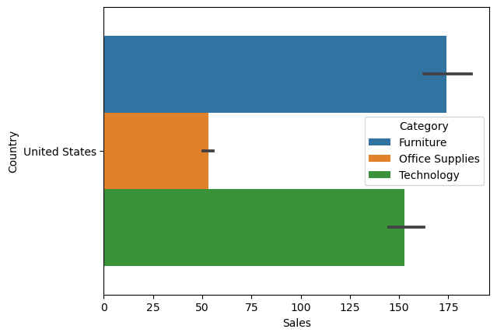
Sales Trends vary across different Regions, Country and Categories
In the Furniture category, the majority of average sales occur in the West region, while in the Office Supplies category, the Central region experiences lowest average sales.
Suggestions:-
1.Marketing and Promotion:- Marketing and Advertising to increase brand visibility and attract more customers.
2.Customer Service:- Provide excellent customer service to build trust and loyalty.
3.Cost Reduction:- Identify and cut unnecessary costs without compromising quality.

Slide 9
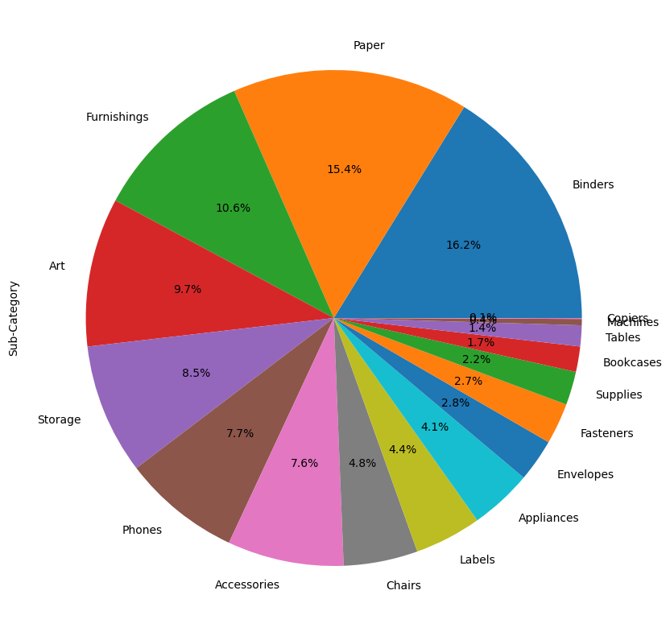
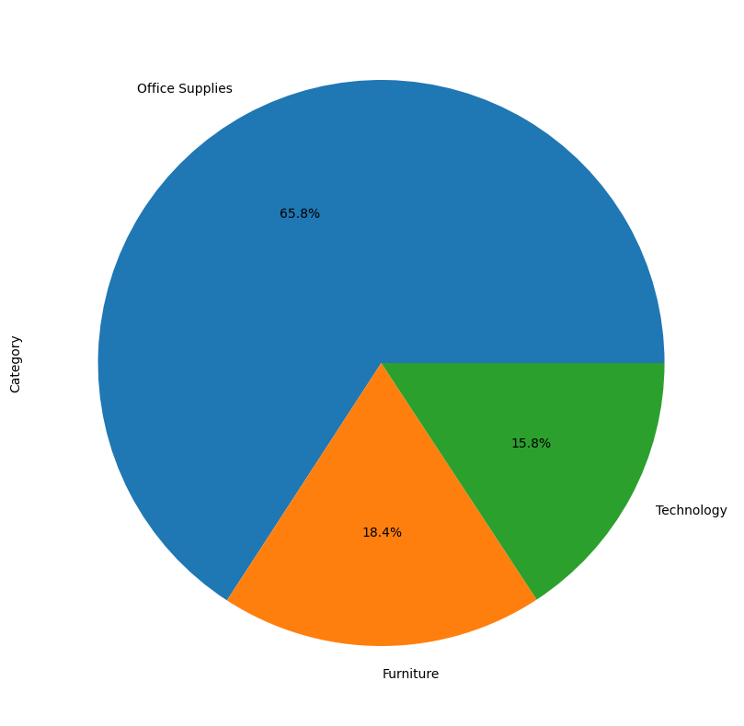
Insights of Categories & Sub-Categories based on
Sales & Profit
In the Pie Chart mentioned above, the
Sub-Category "Binders" accounts for the highest sales at 16.2%, while the Sub-Category "Copiers" represents the lowest sales.
In Category "Office Suppilers" accounts for the highest sales at 65.8%, while the Category "Technology" represents the lowest sales at 15.8%.
Suggestions:-
1.Market Expansion:-Explore new markets and Segments for potential growth, especially in the "Technology" category, which represents the lowest sales. Consider reaching out to different Customer Demographics.

Slide 10
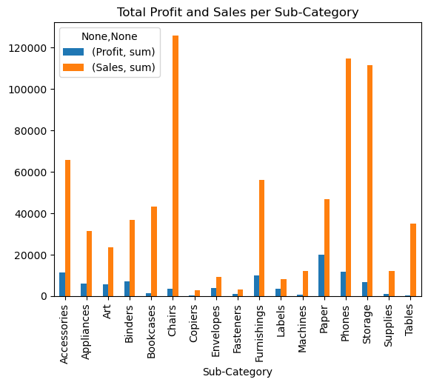
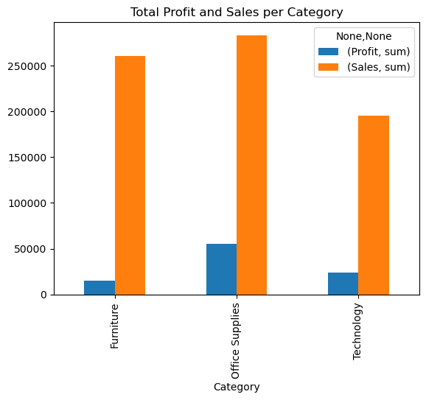
Sub-Category and Category generates the most sales or profit ? And how does it outperform with the others
In the Sub-Category, "Chairs" consistently leads with the highest sales, while "Copiers" and "Tables" generate comparatively lower profits.
At the Category level, "Office Supplies" stands out as the top performer in terms of sales, while "Furniture" lags behind, resulting in lower profitability.

Slide 11
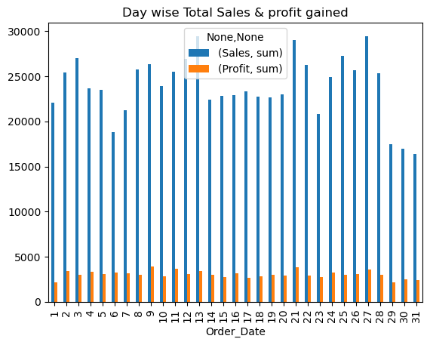
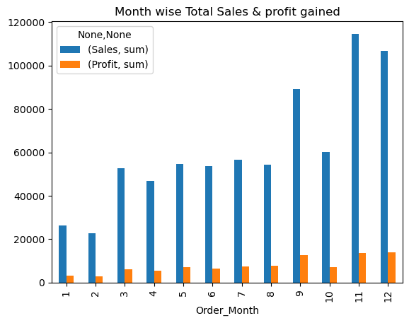
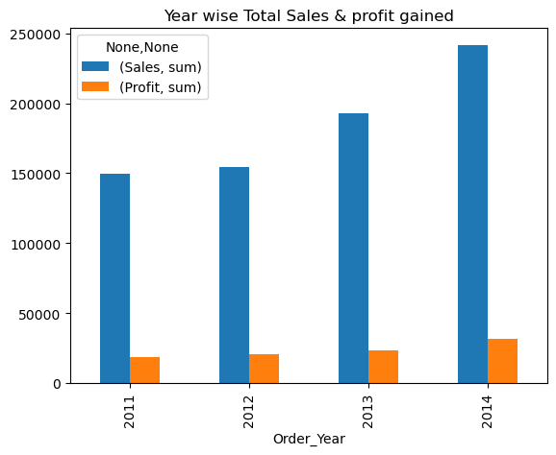
1. Analyzing Sales and Profit based on Order_Date, it's evident that the 27th and 13th of each month consistently yield the Highest Sales, while the 9th and 21st exhibit the Lowest Profit and Sales. Furthermore, the 31st day of the month consistently has the Lowest Sales, with some minor fluctuations seen on a monthly basis.
2.When considering Order_Month, the 11th month consistently achieves the highest Sales and Profit, with the 2nd month recording the lowest sales and profit. Some minor fluctuations can be observed on a monthly basis.
3. In terms of Order_Year, 2014 stands out with the Highest Sales and Profitability, while 2011 records the Lowest Sales and Profits. Year by year, both Sales and Profits show an increasing trend.

Slide 12
Key Findings
Focus on Technology sub-category and Phones and Chairs as they are highest selling and most profitable.
For Home Offices customers, these people might be busy with work and less likely to spend time selecting individual products, so create a Home Office package with products used for offices such as table, chairs, phone, copiers, storage, label, fasteners, bookcases.
For loss-making products like Supplies, Bookcases, Tables, consider to either drop these from the catalogue or change suppliers and bargain for cheaper price.
Consumer and Corporate Segment make up more than 70% of customer base.
Target them, especially customers from the East and West region in the Top 10 cities with Highest Sales by introducing special promotions and bundles for mass Consumer and Home Offices and send promotional emails or flyers.

Slide 13
Conclusion
After a comprehensive analysis of the Super Store Profit Analysis Dataset, several key insights and trends have been identified:-
The main reason which leads to loss is as if some areas lead to loss due to more discounts, and some areas lead to fewer sales due to fewer discounts, hence it needs to be improved.
It is better to give more discounts during festival seasons, additionally, that will result in more sales and profit.
Some cities have fewer sales, lack of awareness can be the reason for this, hence advertising in those cities might help in more sales.
The main reason which leads High sales might be due to a wide variety of products. Consider focusing on higher-margin items.
Maintain quality and customer satisfaction to sustain high-profit margins.

Slide 14


